Slide 1
BowHunter Education

Slide 2
Traditional BowHunter Education course
Course time – 12 hours
Course Content 10 hours
Test – 2 hours

Slide 3
Traditional BowHunter Education course
Test
Question 1 – A bowhunter hits a deer, which then enters posted land. What should the bowhunter do?
A. Immediately enter the property so the deer won’t get away
B. Leave his equipment at the posted sign and then enter
C. Ask the landowner for permission to enter the Property
D. Wait until dark and then retrieve the deer
(This is a question that should not be graded or you should except both B and C)

Slide 4
Traditional BowHunter Education course (Hunter Education Combo)
Course time Approximately 5 hours
Key Chapters:
Chapter 3 (Safe Responsible Bowhunting) 1 hour
Chapter 4 (Know Your Bow and Arrow) 1 hour
Chapter 7 (Shot Placement & Recovery Techniques) 1 hour
Written Test 2 hours

Slide 5
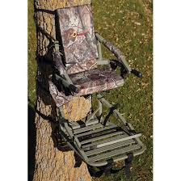
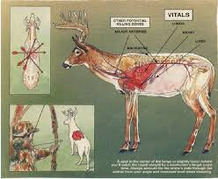
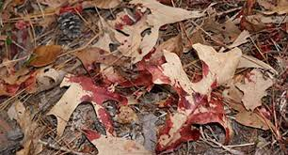
Bowhunter education Field Day
Blood Trailing
Tree Stand Safety
Shot Placement

